Slide 1
Critical Thinking Skills PART 1 – Evaluating information critically
Sourced from:
Lumsden. D, Lumsden. G & Wiethoff. C. 2010. Communicating in groups and teams: Sharing Leadership, Part III: Sharing leadership through task processes: Logical and Critical Thinking, 5th ed. Cengage Learning.

Slide 2
Critical thinking: Learner outcomes
Ability to set norms for critical analysis.
Analyze data to determine what makes it trustworthy and usable or unacceptable & not useful.
Find the strong points & the weak points of ideas and reasoning.
Avoid illogical pitfalls & fallacies in thinking.

Slide 3
.
.
Chapter 1:
Evaluating information critically
The source of information
Information itself
Introduction
Norms for critical analysis

Slide 4

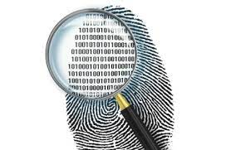
Introduction
Brainpower is essential for success. When we collect data for research, we must remember that all information is NOT equal. Your analysis can separate the garbage from the gold. Analysis = using your brainpower to think logically about information & any conclusions you draw from it.

Slide 5
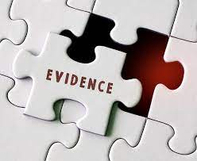

Evaluating information critically
No matter how bright/analytical you are, good analysis requires good information.
Incomplete/false/wrong data = incomplete/false/wrong conclusions.
Evaluating information is therefore crucial.
Curiosity, open-mindedness and conscientiousness are some of the personality traits that correlate with the desire to think critically.
If teams discourage members from questioning and disagreeing, members are not likely to engage their critical thinking skills.

Slide 6


Criteria for analysis
You can’t analyse data critically without some standard of measurement. Consider criteria in 2 areas: | The information’s source The information itself

Slide 7

The information’s source
Suppose Lee brings in a tape & a summary of her interview with an expert – to decide whether the source is good, you evaluate the expert. Now suppose Thandi brings in statistics from an article written by a freelance reporter based on an interview with an expert and published in a magazine – you now have 3 sources to consider: - the expert, - the writer & - the magazine. | Fortunately, many of the same criteria apply to each of these sources, but you cannot overlook 1 source as you analyse another.

Slide 8
The information’s source: 3 broad categories of criteria
The external credibility of the source’s expertise.
The habits of communication the source exhibits.
The ethical inferences you can make from the content of the source’s messages.

Slide 9


3 broad categories examined:
Expertise – If the credibility of you source relies, in part, on his/her expertise, examine the source’s observable expertise & ask: | Qualifications: Are the person’s academic degrees/training/experience sufficient? I.e is the person really an expert on the issue? Reputation: Is the person acknowledged and respected by other experts in the field? Do other experts refer to or quote this person as a source?

Slide 10

3 broad categories examined:
2. Habits of communication – If the source passes the previous tests, you then examine other aspects of communication to assess the source’s credibility. Karl Wallace (1955) provides the following 4 criteria for examining a communicator’s ethics: | Habit of search Habit of justice Habit of preferring public to private motivations Habit of respect for dissident

Slide 11
Karl Wallace criteria
Habit of search: The knowledgeable, thorough presentation of sound information. Does your source document information? Prove any assertions? Are the source’s data complete? Is the source’s habit of search ethically acceptable (e.g. not abusing the environment or animal or human subjects)? | 2. Habit of justice: Fairness in presenting information so that an audience can assess it equitably. Is the source known to be trustworthy & honest? Is the source normally clear & direct in dealing with issues & people, or does the source have a history of manipulation & strategy in such dealings?

Slide 12
Karl Wallace criteria
3. Habit of preferring public to private motivations: Openly letting people know about the source’s own sources, plans and expectations. Are the source’s previous actions consistent and reliable? Do contradictions in behaviour or quality put this source in doubt? | 4. Habit of respect for dissident: The ability to remain objective and to encourage dialogue about opposing arguments & positions. Does the source have a history of bias toward a political, social, or philosophical position, or does the source typically present & listen to more than one side of an issue?

Slide 13
3. Ethical inferences
Messina (2007) suggests additional guidelines to use when evaluating persuasive messages. | 1st = respect for the audience: Is the information presented in such a way that the audience can make a voluntary, informed & rational judgment about it? Or is the source using “bullying” tactics that try to force agreement? ^{2nd} = does the source show respect for the material? Is the message presented in a way that both respects the audience’s current views & adequately provides new information?

Slide 14
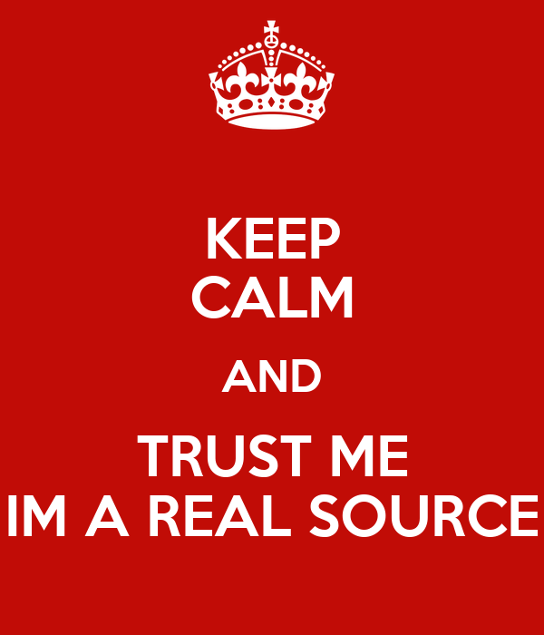
Ethical inferences cont…
These criteria – the external credibility of a source’s expertise, habits of communication, & inferences about respect for the audience & the material – can help you decide how much to trust the information’s source.

Slide 15
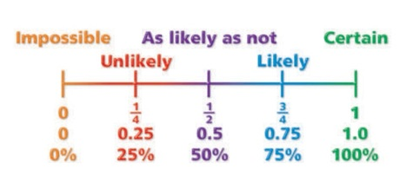
The information itself
When you start to accumulate information, you make an interesting discovery –
Conclusions from data may be possibly true, or probably true, but are hardly ever absolutely true.
We must know how probable something is.

Slide 16

So how do you assess probability?
Weighing various pieces of evidence that seem to support or refute an idea. As you go through the information you’ve collected, the team becomes judge and jury = you assess each piece of information in terms of its quality, and then weigh any contradictory pieces against each other. | Ask yourself: Which evidence pertains most directly to the issue or question at hand? Which conclusion has the most evidence on its side? The best conclusion = the 1 that is most probably true = is the 1 supported by the preponderance of quality evidence, i.e: There’s more credible data backing that conclusion than backing other conclusions.

Slide 17
Questions to ask when analyzing information in general:
For e.g. you have been asked to improve the quality of student life
and have obtained results of a survey taken at another university (UCT)
3 years ago:
Is the information valid? Does it actually measure what it intends to measure? Does it apply to the issues & questions relevant to the students at your university? Would students today be very different from those surveyed 3 years ago? | 2. Is the data reliable? To what extent is the data consistent? E.g. on this survey, if the question, “Are you comfortable at UCT?” gets a strong “YES”, but the question, “Do you feel at home at UCT?” gets a strong “NO”, then the reliability may be questionable.

Slide 18
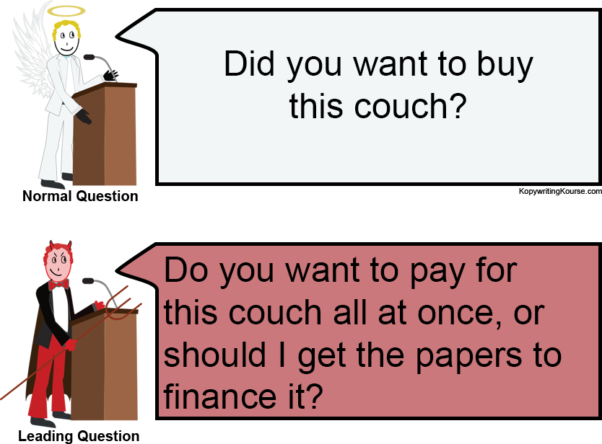
Questions to ask when analyzing information in general:
3. Is the information truthful & objective? Does the report present more than one side of the issues? Was the data gathered objectively? If the survey uses biased questions such as “Should UCT reduce its excessive fees for activities?”, it lacks objectivity. | 4. Is the information sufficient? How much information is enough depends on the questions involved and what you need to know about them. - Are the questions inclusive? - Do they focus on facts, values, or policies? - What more might you need to know?

Slide 19
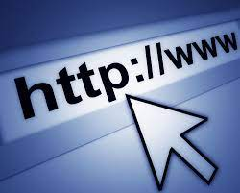
Internet information
Web sites are often cited as source of information. BUT a website is just a site (virtual location) not a source. Saying that info comes from a specific site is like reporting which library a book comes from! You need to know who wrote or who prepared the material you found at that location, & you need to apply the criteria for analyzing the credibility of the source & the quality of the information developed in the previous sections.

Slide 20
Internet information
Internet information raises these additional concerns:
MOTIVES
Web sites are built for specific purposes – each has its own agenda. Material prepared & selected to achieve those goals and not to provide an objective point of view. Approach websites expecting a bias, and evaluate information with caution.
When getting information from the Internet, you need to know both that it’s really coming from the source with which it’s identified and that it’s being accurately reported. Anyone can easily send fraudulent messages - & someone else can pick them up as accurate data.
ACCURACY

